Slide 1


Michael S
7/14/2024

Slide 2

Outline
Executive Summary
Introduction
Methodology
Results
Conclusion
Appendix

Slide 3
Executive Summary
Summary of methodologies
Data collection through SpaceX API and web scraping
Data wrangling to prepare for analysis
Exploratory data analysis with SQL & visualizations
Interactive data analysis with Folium maps & Plotly dashboard
Machine learning algorithm for predictions
Summary of all results
Launch success rate has increased over time
Most launch sites are located in the southern US, on coasts, and away from cities
All predictive models performed similarly, with an 83% accuracy rate

Slide 4
Introduction
Background
Space X advertises Falcon 9 rocket launches on its website with a cost of 62 million dollars; other providers cost upward of 165 million dollars each, much of the savings is because Space X can reuse the first stage. Therefore, if we can determine if the first stage will land, we can determine the cost of a launch
Explore
How do features, such as number of flights, launch site, payload mass, orbits, and boosters affect landing success
Find trend of successful landings over time
Identify best predictive model for future launches

Slide 5

Section 1

Slide 6
Methodology
Executive Summary
Data collection methodology:
SpaceX API and web scraping
Perform data wrangling
Filtered data set as needed, addressed missing values, and applied one hot encoding for machine learning
Perform exploratory data analysis (EDA) using visualization and SQL
Perform interactive visual analytics using Folium and Plotly Dash
Perform predictive analysis using classification models
Used GridSearchCV to find the optimum parameters, then compared models using accuracy score

Slide 7
Data Collection
Data was collected from Space X API
Additional data was scraped from Wikipedia
Data was then filtered and wrangled to create a data set of Falcon 9 launches

Slide 8
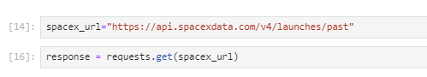
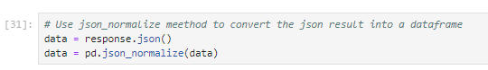
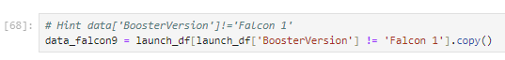
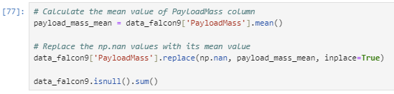
Data Collection – SpaceX API
GET request was used to retrieve launch data
Returned JSON data was converted to Pandas data frame
Key features were identified and compiled into a new data frame, then filtered to only include Falcon 9
Lastly, missing payload mass values were filled in using the mean value method
GitHub URL https://github.com/msalte2006/IBM-Data-Science-SpaceX-Capstone/blob/main/jupyter-labs-spacex-data-collection-api.ipynb

Slide 9
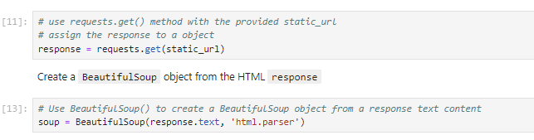
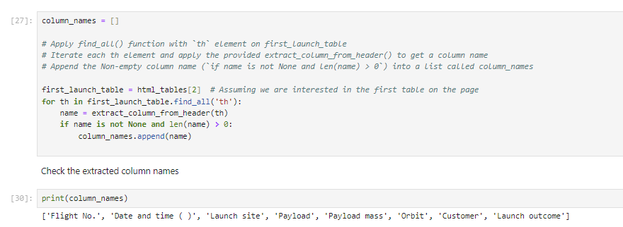
Data Collection - Scraping
Used GET request retrieve Falcon 9 launch data from Wikipedia
Created BeautifulSoup object from the response content
Retrieved column names from HTML table
Lastly, the HTML tables were parsed and placed into a data frame
GitHub URL: https://github.com/msalte2006/IBM-Data-Science-SpaceX-Capstone/blob/main/jupyter-labs-webscraping.ipynb

Slide 10
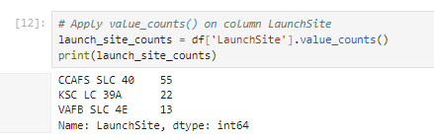
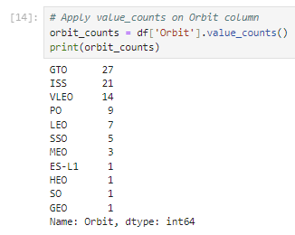
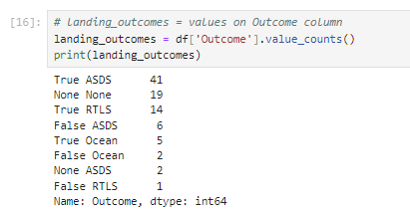
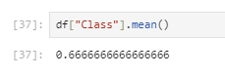
Data Wrangling
Number of launches per site was calculated
Number and types of orbits were calculated
Mission outcomes were determined
Lastly, a "class" was created to indicate if the landing was successful (1) or not successful (0). This was added to the data frame for additional analysis
The average success rate was determined to be 66.6%
GitHub URL: https://github.com/msalte2006/IBM-Data-Science-SpaceX-Capstone/blob/main/labs-jupyter-spacex-Data%20wrangling.ipynb

Slide 11
EDA with Data Visualization
Various charts were utilized to explore the data
Scatterplot to explore flight number and payload on outcome
Scatterplot to explore flight number and launch site on outcome
Scatterplot to explore payload and launch site on outcome
Bar chart to visualize success rate of each orbit
Scatterplot to explore flight number and orbit type on outcome
Scatterplot to explore payload and orbit type on outcome
Line plot to visualize success rate over time
By exploring the data visually, we can gain preliminary insights to how important each variable is to the success rate, allowing us to pick features for our prediction model
GitHub URL: https://github.com/msalte2006/IBM-Data-Science-SpaceX-Capstone/blob/main/jupyter-labs-eda-dataviz.ipynb

Slide 12
EDA with SQL
Retrieved the distinct names of each launch site
Retrieved top five records where one site begins with CCA
Calculated the total payload mass carried by boosters launched by NASA (CRS)
Calculated the average payload mass carried by booster version F9 V1.1
Retrieved the first successful ground pad landing date
Retrieved the boosters which have success in drone ship and have a payload mass between 4000 and 6000
Calculated the total number of successful and failure mission outcomes
Retrieved the booster versions that have carried the maximum payload mass
Retrieved the failure records for drone ship in the year 2015
Ranked the landing outcomes by count between specified dates
GitHub URL: https://github.com/msalte2006/IBM-Data-Science-SpaceX-Capstone/blob/main/jupyter-labs-eda-sql-coursera_sqllite.ipynb

Slide 13
Build an Interactive Map with Folium
All launch sites were marked on the map to visualize locations
Marker clusters were used on each launch site to visualize success and failure outcomes
Lines and distances were added to understand the proximity to railways, highways, and cities
GitHub URL: https://github.com/msalte2006/IBM-Data-Science-SpaceX-Capstone/blob/main/lab_jupyter_launch_site_location.ipynb

Slide 14
Build a Dashboard with Plotly Dash
Graphed total successes by site, to see which launch sites had the highest successful launches, and which had the highest success rate
Graphed payload success rates, to visualize the impact of payload and booster version on success
The dashboard also has filters to allow flexibility in data exploration
GitHub URL: https://github.com/msalte2006/IBM-Data-Science-SpaceX-Capstone/blob/main/spacex_dash_app.py

Slide 15
Predictive Analysis (Classification)
Data was preprocessed and split into training and test data sets
The data was then trained on multiple models, using GridSearchCV to find the optimized parameters for each model
The models used were logistic regression, SVM, decision tree, and K nearest neighbors
Accuracy was scored against the test data set to find the best model
While the decision tree had the highest accuracy on the training data, all models performed the same on the test data. Consequently, no model had any advantage over the others
GitHub URL: https://github.com/msalte2006/IBM-Data-Science-SpaceX-Capstone/blob/main/SpaceX_Machine_Learning_Prediction_Part_5.jupyterlite.ipynb

Slide 16
Results
Exploratory data analysis results
The success rate has improved over time
KSC LC-39A has had the greatest number of successful launches
CCAFS SLC-40 has had the least number of successful launches, but the highest success rate
Success rates vary by orbit as well, with ES-L1, GEO, HEO, SSO, and VLEO being the highest
Interactive analytics
Launch sites are typically located in the southern US on the coast
They are far from cities, but still accessible by highways
Predictive analysis results
All models performed the same, with 83% accuracy

Slide 17

Section 2

Slide 18
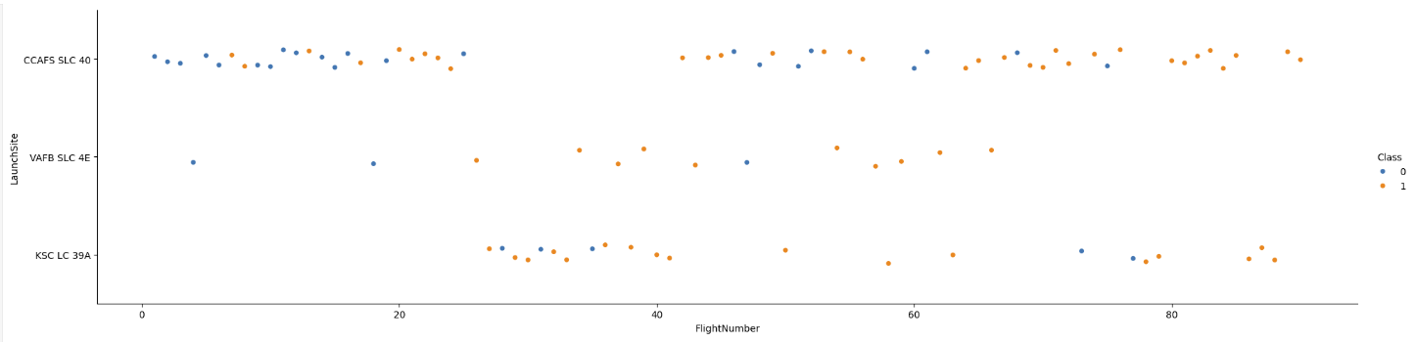
Flight Number vs. Launch Site
There was an increase in the success rate over time from the CCAFS SLC 40 launch site

Slide 19
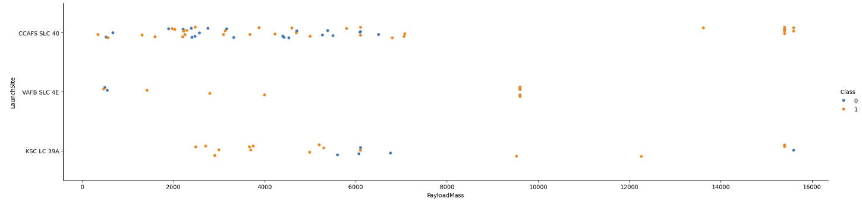
Payload vs. Launch Site
Higher payloads tend to have higher success rates at the CCAFS SLC 40 launch site
VAFB SLC 4E did not have any heavy payload masses greater than 10,000

Slide 20
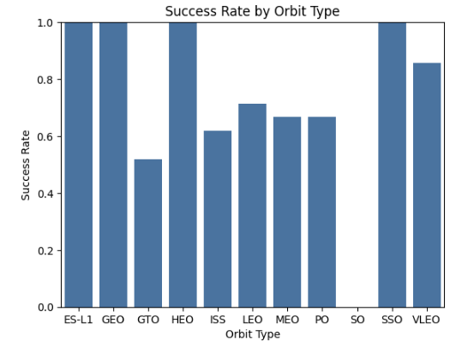
Success Rate vs. Orbit Type
Charting the orbit success rate: ES-L1, GEO, HEO, SSO, VLEO had the highest rates

Slide 21
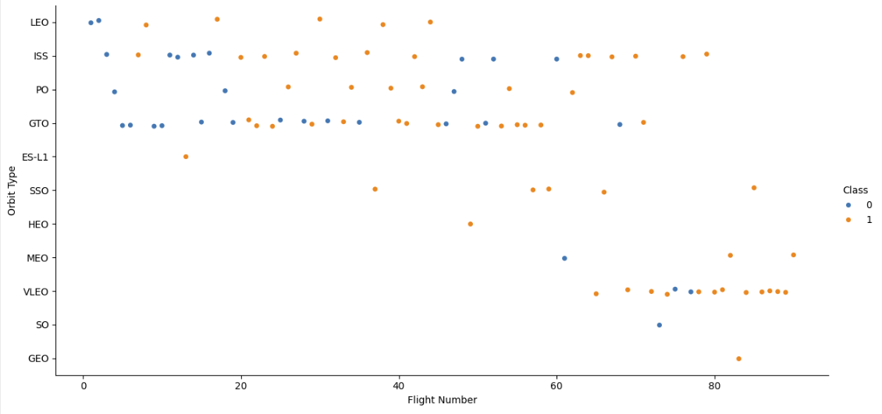
Flight Number vs. Orbit Type
LEO demonstrates increased success related to flight number
GTO does not show a relationship between success and flight number

Slide 22
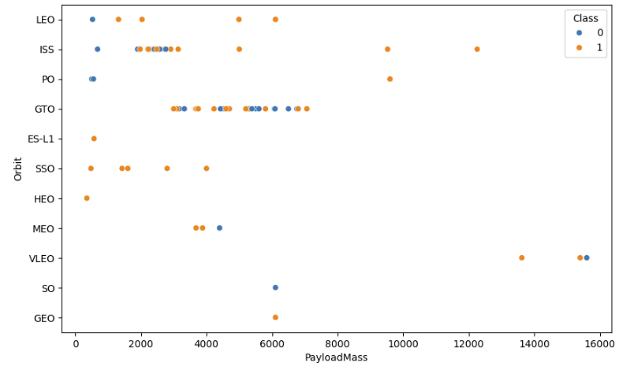
Payload vs. Orbit Type
With heavy payloads the successful landing rate is more for Polar, LEO and ISS
For GTO we cannot distinguish this well as

Slide 23
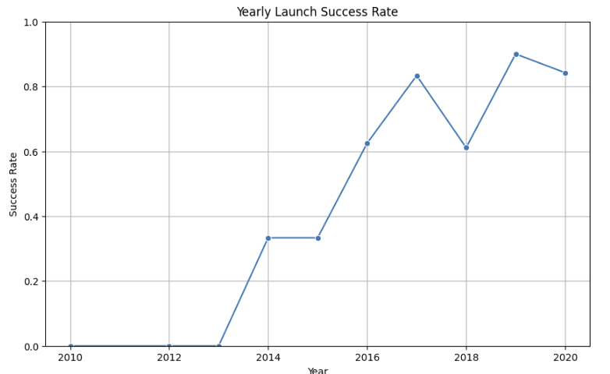
Launch Success Yearly Trend
Over time, the yearly launch success rate has continually increased
There was a dip in 2018 & 2020, but the trend is upward

Slide 24
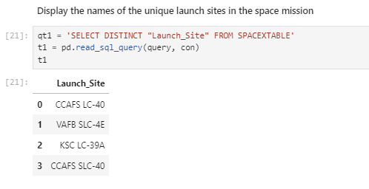
All Launch Site Names
There were four distinct launch sites found

Slide 25
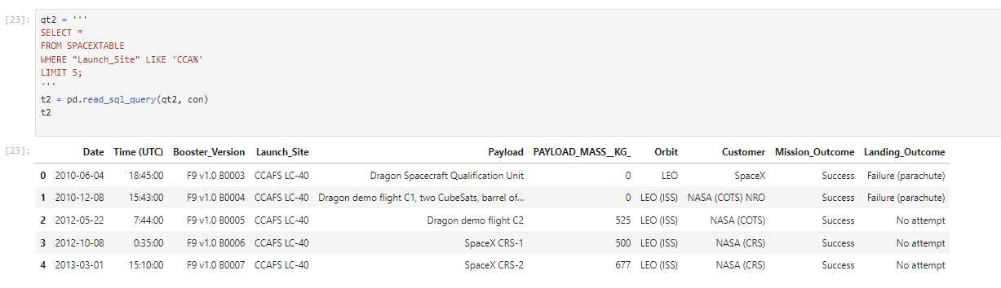
Launch Site Names Begin with 'CCA'
5 records where launch sites begin with `CCA`

Slide 26
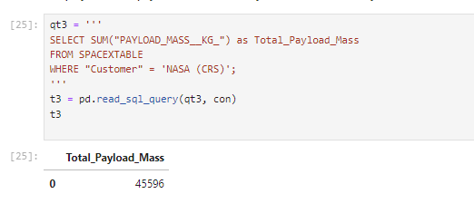
Total Payload Mass
Total payload carried by boosters from NASA : 45,596 kg

Slide 27
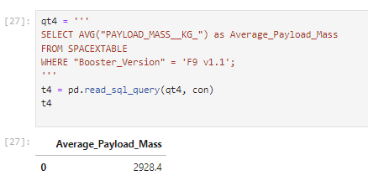
Average Payload Mass by F9 v1.1
Average payload mass carried by booster version F9 v1.1 : 2928.4 kg

Slide 28
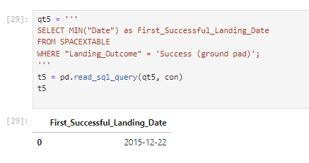
First Successful Ground Landing Date
First successful landing outcome on ground pad : 12/22/2015

Slide 29
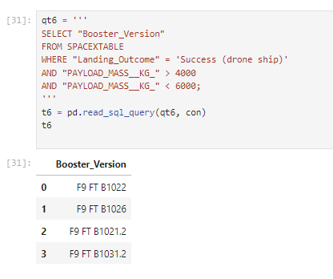
Successful Drone Ship Landing with Payload between 4000 and 6000
Names of boosters which have successfully landed on drone ship and had payload mass greater than 4000 but less than 6000
Of note: they are all FT boosters

Slide 30
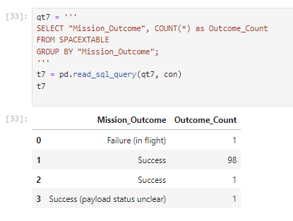
Total Number of Successful and Failure Mission Outcomes
Total number of successful and failure mission outcomes

Slide 31
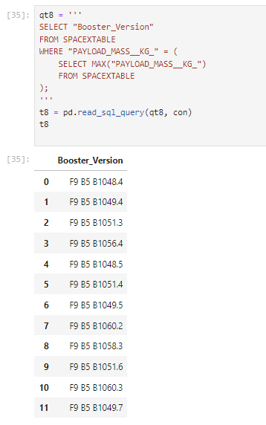
Boosters Carried Maximum Payload
Names of the booster which have carried the maximum payload mass
Of note: they are all B5 boosters

Slide 32
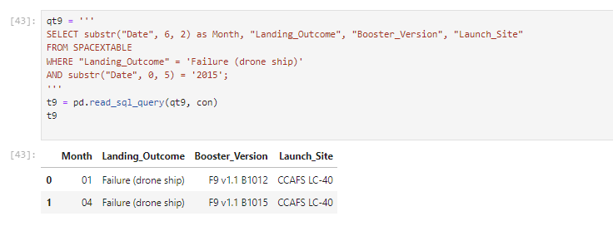
2015 Launch Records
Failed landing_outcomes in drone ship, their booster versions, and launch site names for in year 2015

Slide 33
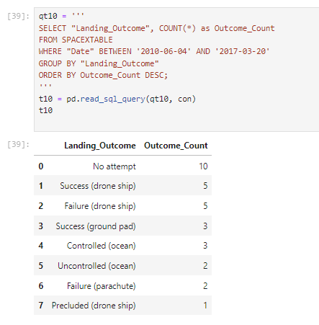
Rank Landing Outcomes Between 2010-06-04 and 2017-03-20
Count of landing outcomes (such as Failure (drone ship) or Success (ground pad)) between the date 2010-06-04 and 2017-03-20, in descending order

Slide 34

Section 3

Slide 35
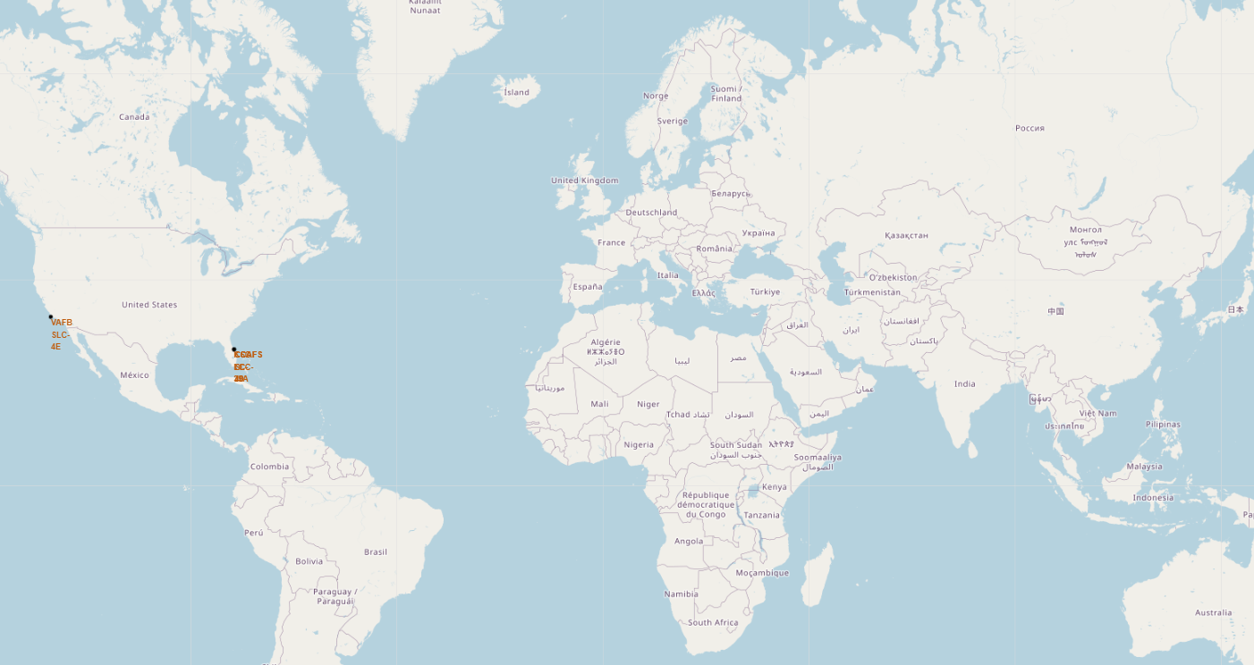
Launch Sites
With the launch sites mapped, we see that they are located in the southern US and on the West and East coasts

Slide 36
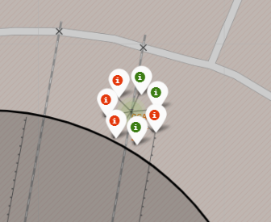
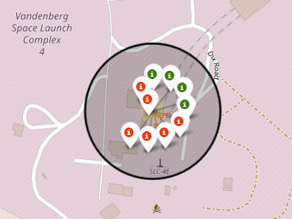
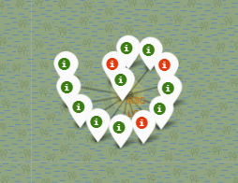
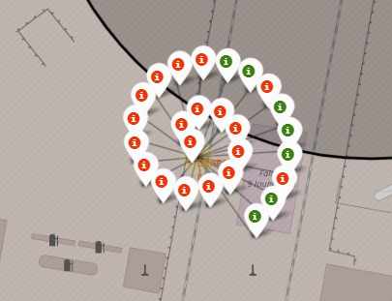
Launch Success Rate by Site
By mapping the launches and coloring by success or failure, we can visualize both the quantity of launches at each site and the number of successes versus failures

Slide 37
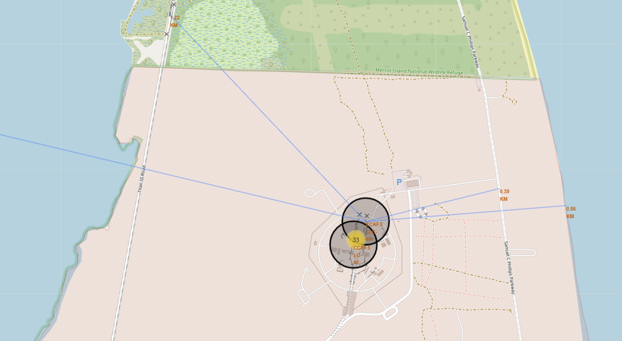
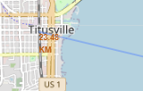
Launch Site Distance to Other Map Objects
Launch sites may be located near railways, highways, and coastlines
Launch sites are typically located away from cities

Slide 38

Section 4

Slide 39
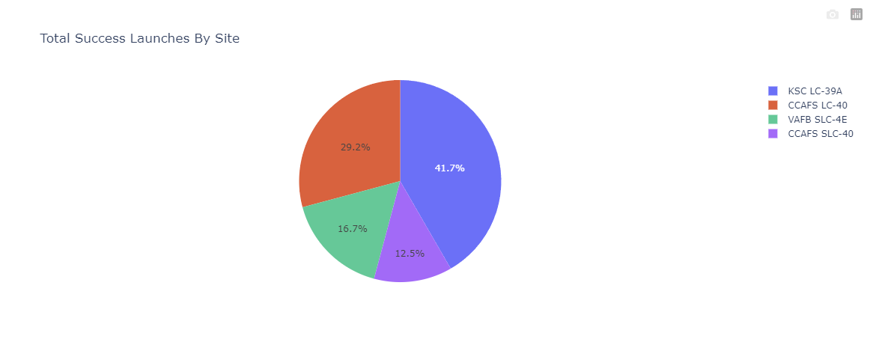
Successful Launches by Site
KSC LC-39A has had the greatest number of successful launches
CCAFS SLC-40 has had the least

Slide 40
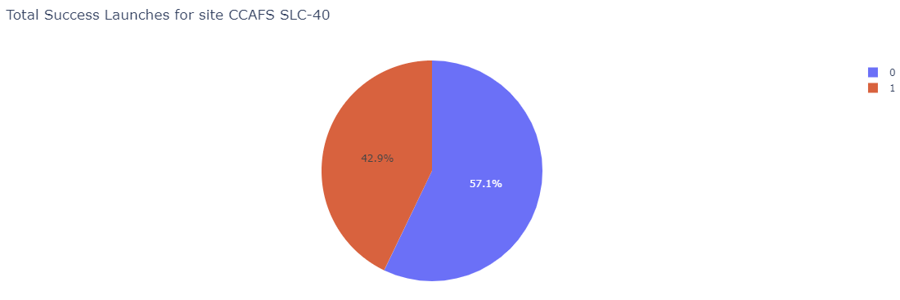
Launch Site with Highest Success Ratio
CCAFS SLC-40 had the highest success rate for launches at approximately 43%

Slide 41
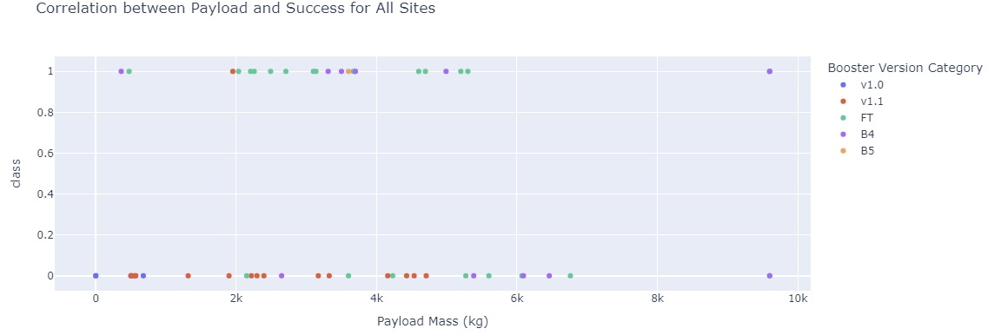
Success Rate Based on Payload and Booster Version
The FT booster has had the highest number of successful launches
v1.1 has had the most unsuccessful launches

Slide 42

Section 5

Slide 43
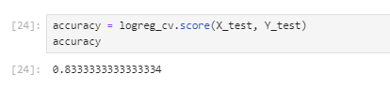
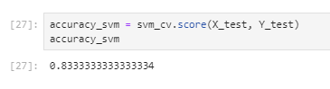
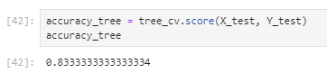
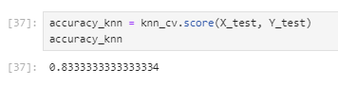
Classification Accuracy
The accuracy of classification on the test data was identical among all the models, 83.3%

Slide 44
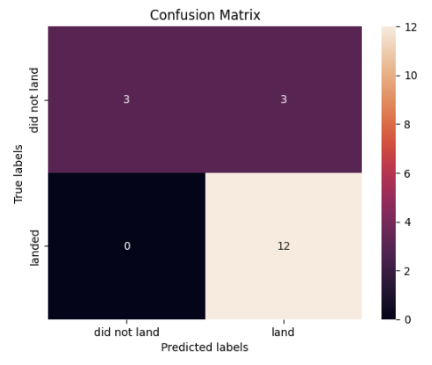
Confusion Matrix
All the models performed the same and generated the same confusion matrix
All landings were predicted correctly, but there were some failures that were predicted incorrectly (false positives)

Slide 45
Conclusions
Launch success rate has improved over time
KSC LC-39A has had the greatest number of successful launches
CCAFS SLC-40 has had the least number of successful launches, but the highest success rate
Launch sites are located in the southern US (closer to the equator), close to coastlines, and away from cities
All predictive models performed the same, with approximately 83% classification accuracy

Slide 46
Appendix
GitHub project link: https://github.com/msalte2006/IBM-Data-Science-SpaceX-Capstone

Slide 47


